Slide 1

Frequency of what:
How simple is the story of syntax acquisition?
Amanda Nili
In collaboration with Lisa Pearl
Notes:
Use icon from webpage

Slide 2
A Preview
How do we know right from wrong, grammatically speaking?
A simple theory of language acquisition: how often we hear something (a syntactic structure) determines how correct that structure is
Is the simplest version of this story true?
Looking at child-directed speech (because this is a study of acquisition)
End result: syntax acquisition is not so simple (problems with the kind of frequency)

Slide 3

A Theory of Language Acquisition
Relationship between frequency & grammaticality: If our brains are great computers (i.e., tracking statistics), they will be able to take in all of the data, analyze the frequency of every structure’s use, then translate that to how acceptable the structure is, right?

Slide 4
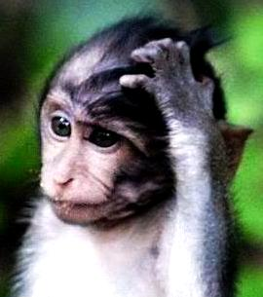
Frequency of what?
Frequency of structure use

Slide 5
Frequency of what?
Still, there are different ways of analyzing frequency:
  direct reflection (simple): we analyze the most surface forms and make minimal abstraction about the structure we hear
  something more sophisticated (less simple)

Slide 6
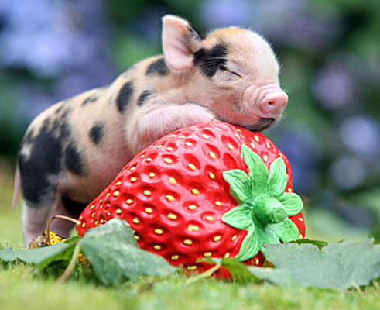
Frequency of what?
  Subject (determiner + singular noun) + present tense intransitive verb.
  This appears 20 times.
  Ex: The pig grunts.

Slide 7
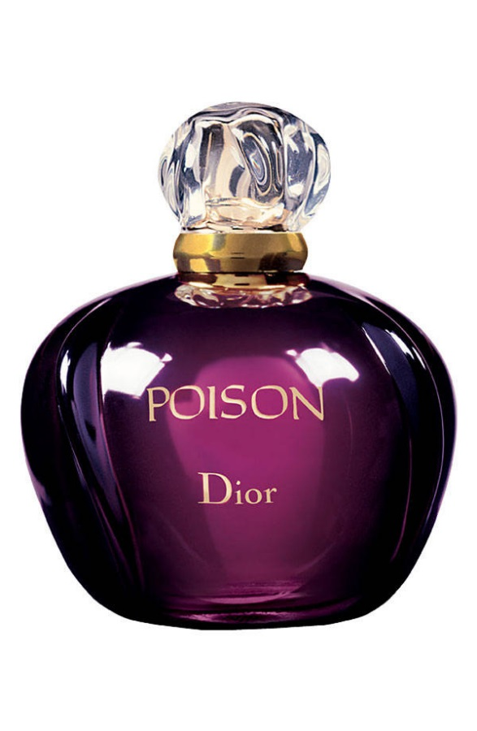
Frequency of what?
  “Who” + auxiliary verb + subject (noun phrase) + transitive verb?
  This appears 43 times.
  Ex: Who did Marvin poison?

Slide 8
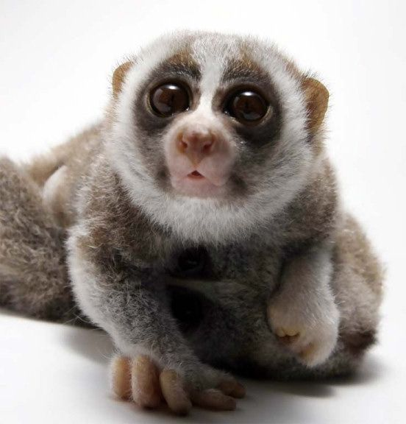
Measuring grammaticality how?
Grammaticality of that structure (how grammatical native speakers think it is) – often assessed by an acceptability score (an average of scores from multiple instances of each structure to control for semantic influence, which we hope reflects grammaticality in a well-controlled experiment)

Slide 9
Measuring grammaticality how?
These acceptability scores are actually Z-scores (ranging from -1.19 to +1.13): they test standard deviation from the mean, and the direction of that deviation

Slide 10
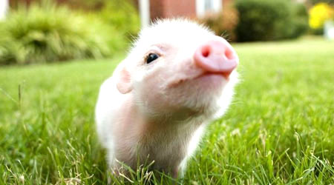
Measuring grammaticality how?
  Subject (determiner + singular noun) + present tense intransitive verb.
  Acceptability score: 0.65.
  Ex: The pig grunts.
  Reminder: Structure appears 20
  times.

Slide 11
Measuring grammaticality how?
  “Who” + auxiliary verb + subject (noun phrase) + transitive verb?
  Acceptability score: 1.12.
  Ex: Who did Marvin poison?
Reminder: Structure appears 43 times.
Notes:
Fix all these

Slide 12
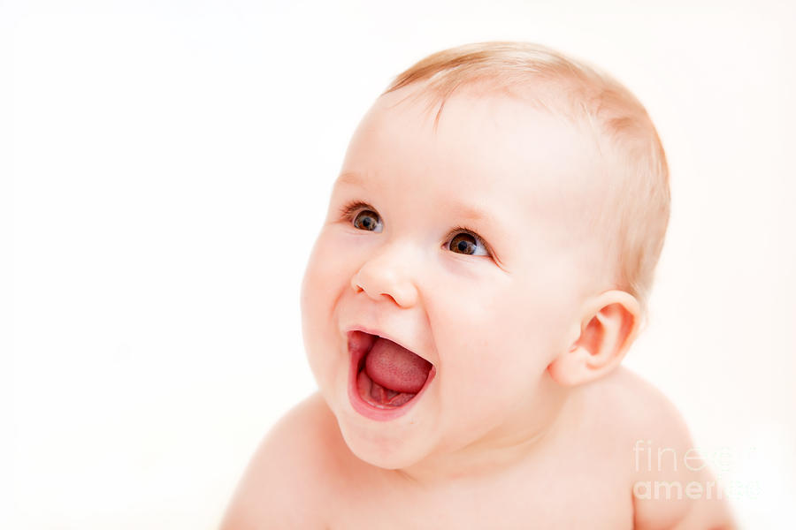
The simple story would look something like this:
+Acceptability
+Frequency
-Frequency
-Acceptability

Slide 13
The simple story would look something like this:
+Acceptability
+Frequency
-Frequency
-Acceptability

Slide 14
Is the simple story true?
Previous studies have found a gap: frequency values not matching perfectly (or even well) with acceptability scores
Different explanations as to why that gap exists

Slide 15
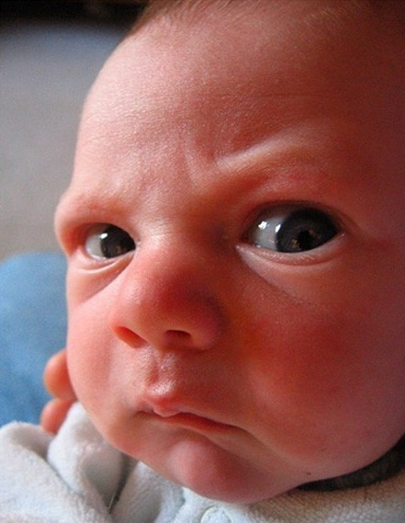
The “gap” and other problems for the simple story:
+Acceptability
Quadrant II
+Frequency
-Frequency
Quadrant IV
-Acceptability

Slide 16
Who believes the simple story?
Kempen and Harbusch (2005): “[Object to findings of a frequency-grammaticality gap on the basis that] … quite a few orderings that are rated at least average to grammatical quality also have zero corpus frequencies.”
  Bad Method: The simple correlation is there, it’s just that your naïve native speakers don’t know what they find acceptable and what they don’t, so they’re rating utterances as more acceptable than they actually are!
Notes:
In explaining the gap, say it doesn’t actually exist: you’d find the correlation if you were looking for it properly!

Slide 17
Actually, the method is fine…
Sprouse & Almeida (2012): different methods of collecting acceptability data accused of unreliability; a comparison of data from all methods shows that’s not the case (all methods are pretty convincingly reliable)

Slide 18
Maybe it’s not so simple…
Jurafsky (2002): “… the mismatch between corpus frequencies and psychological norming studies is to be expected. These are essentially two different kinds of production studies, with different constraints on the production process.”
  When linguists try to compare these two data sets, they are doing something fundamentally incorrect: we don’t find an r of 1 because, perhaps, acceptability data (from psychological norming studies) are expressive of something more abstract, whereas the frequency data are more concrete

Slide 19
Not so simple: Linear Optimality Theory
Keller (2000): the acceptability-frequency relationship isn’t so straight forward. It’s about how significant a linguistic constraint (and its violation) is.

Slide 20
Not so simple: Linear Optimality Theory
Hard constraint: Subject-Verb Agreement
  Trish has painted a picture of Arthur.
  *Trish have painted a picture of Arthur.
Soft constraint: Definite Article Use
  Which friend has Trish painted a picture of?
  *Which friend has Trish painted the picture of?

Slide 21
Really not so simple
Pearl & Sprouse (2013): these authors make the comparison between frequency and acceptability data.
  Frequency of what? Really abstract representations (WH-questions).
  Find no obvious correlation at that level of abstraction.
  [_{CP} Who did [_{IP} she [_{VP} like _]]]?

Slide 22
Really not so simple
Note: Pearl & Sprouse’s (in prep.) study of WH-questions has found a less-than-great correlation between adult-directed speech frequencies and grammaticality (as measured by acceptability).
Notes:
Normalize

Slide 23
Not found (by Pearl & Sprouse):
+Acceptability
+Frequency
-Frequency
-Acceptability

Slide 24
What about child-directed speech?
(1) Important for understanding how we learn to have these grammaticality intuitions.
(2) Known differences at various levels between child-directed and adult-directed speech (e.g. motherese). Maybe there’s a significant difference at the structural level, when looking at less abstract things. (Often there is a difference for sound distributions, words, and simple structures. Although Pearl & Sprouse find it does not apply for wh-dependencies).

Slide 25
Acceptability Data
Collected by Sprouse & Almeida (2012), using utterances in the Adger’s Core Syntax textbook for linguistics students
  Scores assigned by naïve native speakers using multiple data-collection methods
  Each structure presented multiple times, using different words:
    Collected averages of the multiple iterations => one averaged score per structure

Slide 26
Frequency Data
Child-directed utterances from CHILDES data base, the following corpora:
  Brown-adam (26,280 utterances): ages 2;3-4;10
  Brown-eve (14,245): 1;6-2;3
  Brown-sarah (46,948): 2;3-5;1
  Soderstrom (21,334): 0;6-1; 0
  Suppes (35,906): 1;11-3;11
  Valian (25,550): 1;9.20-2;8.24
    Total => 170,263
Notes:
Explain notation: Brown-adam looks at ages 2 years and 3 months through 4 years and 10 months

Slide 27
Frequency values are negative because the normalized values are very small numbers, so each is the log₁₀ of the calculated frequency.
For example: “The pig grunts.” Appears 20 times, has a frequency score of 0.000117465, which we take log₁₀ of, to get the more easily graphed (negative) value of
-3.930090286.
+Acceptability
+Frequency
-Frequency
-Acceptability
Notes:
Explain the example.

Slide 28
The expectation:
+Acceptability
+Frequency
-Frequency
-Acceptability

Slide 29
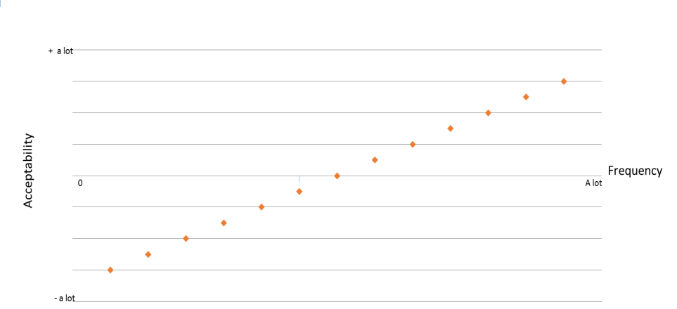
Not Pictured:
r = 1
Frequency values are negative because they are log₁₀
r = 0.509

Slide 30
Comparing Sprouse & Almeida’s 2012 study of acceptability scores [of 219 structures] rated by naïve native speakers with the actual frequency of utterance appearance in the CHILDES corpora (using child-directed speech only) results in some questionable data:
+Acceptability
Quadrant II
+Frequency
-Frequency
Quadrant IV
-Acceptability

Slide 31
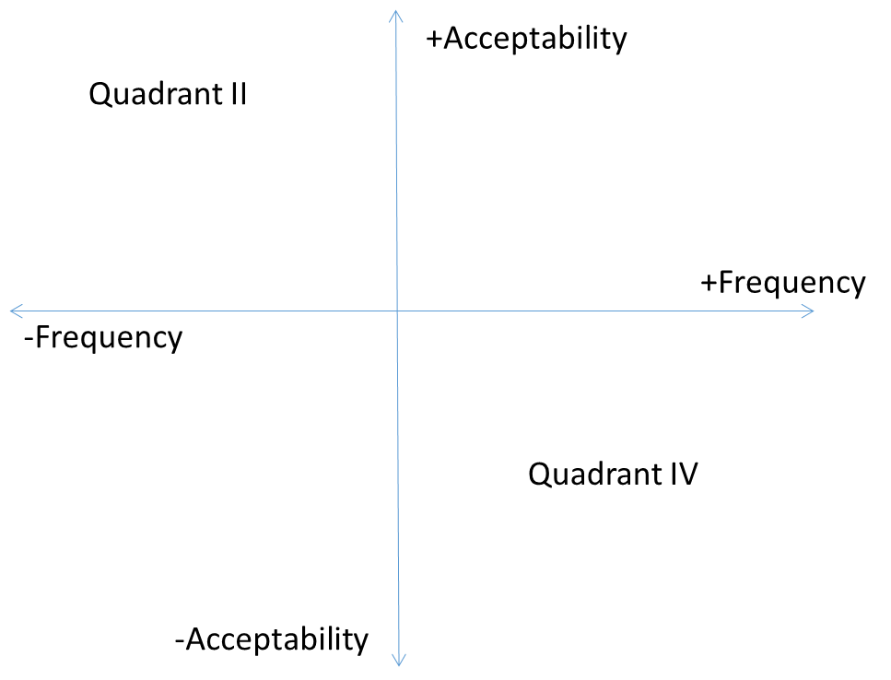
High acceptability and low frequency
  High acceptability (0.80) and low frequency (occurs 2 times): Subject (nominative pronoun) + “have”-auxiliary +transitive verb past participle + object (accusative pronoun)
  Example: She has kissed her.

Slide 32
Low acceptability and existent frequency
  Low acceptability (-0.09) and existent frequency (occurs 7 times): NP = [singular count noun with no determiner] + verb + PP, nothing after
  Example: *Letter is on the table.
  Consider that a high acceptability utterance (“Joss’s idea is brilliant”) has the same raw frequency score, but an acceptability score of 1.07.

Slide 33
Low frequency (occur 0 times) and varying degrees of low acceptability:

Slide 34
Low frequency (occur 0 times) and varying degrees of low acceptability:
Subject + tensed verb “wonder” + wh-object fronted + subject + auxiliary + transitive verb?
  Example: I wondered who did Marvin poison?
      Acceptability score: -0.18
  Subject (name) + be + object (plural noun).
    Example: Peter is pigs.
        Acceptability score: -1.20

Slide 35
The data suggest:
Frequency of simple structures is NOT the only factor to determine how acceptable structures are to native speakers
(Not the simple version)

Slide 36
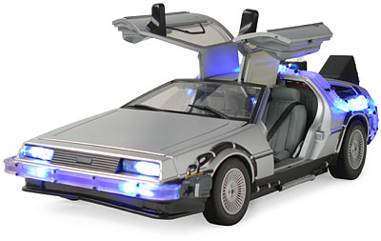
Future directions for research:
Child-judgment data
The different levels at which we study frequency

Slide 37
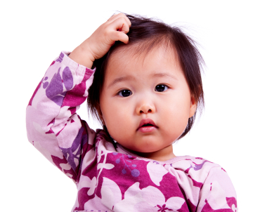
Future directions for research: Child judgment data
Children learning a first language very likely don’t perceive that language the same way adults do, but we compare frequency of linguistic input against adult judgment data – this may not be telling us enough about how children learn what’s acceptable and what’s not
Notes:
Creative commons

Slide 38
Future directions for research: Different kinds of frequency
Frequency of what?
  Different levels of abstraction may be necessary for the different kinds of unacceptable utterances
  Example: “The book ran.” v “The thief ran.”
    We accounted for semantic category violations such as “The book ran.” However…
Consider: some of the utterances may show correlation between frequency and acceptability, because less abstract level of comparison is appropriate—other utterances may require something more abstract in order to correlate their acceptability scores with their frequencies.
Notes:
If we know that varying levels of abstraction are necessary for different violations, there may be some that have no been accounted for (just as “The book ran” is not accounted for by only part-of-speech notation).

Slide 39
About that question…
Can we account for syntax acquisition with a simple story, or do we need something more sophisticated (a different understanding of frequency) to make sense of the data?

Slide 40

Frequency of what?:
“The penguins.”
DT NNS
NP
DT-bird
NP-animate
We know that base frequencies of structure usage don’t correlate well with acceptability judgment data
This could be because base frequencies are only part of the story
Future research should focus on the frequency of what: determining how abstracted our information about syntax is

Slide 41
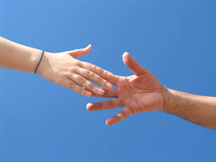
A special thanks to:
Lisa Pearl
The Computation of Language Laboratory
UROP

